Slide 1
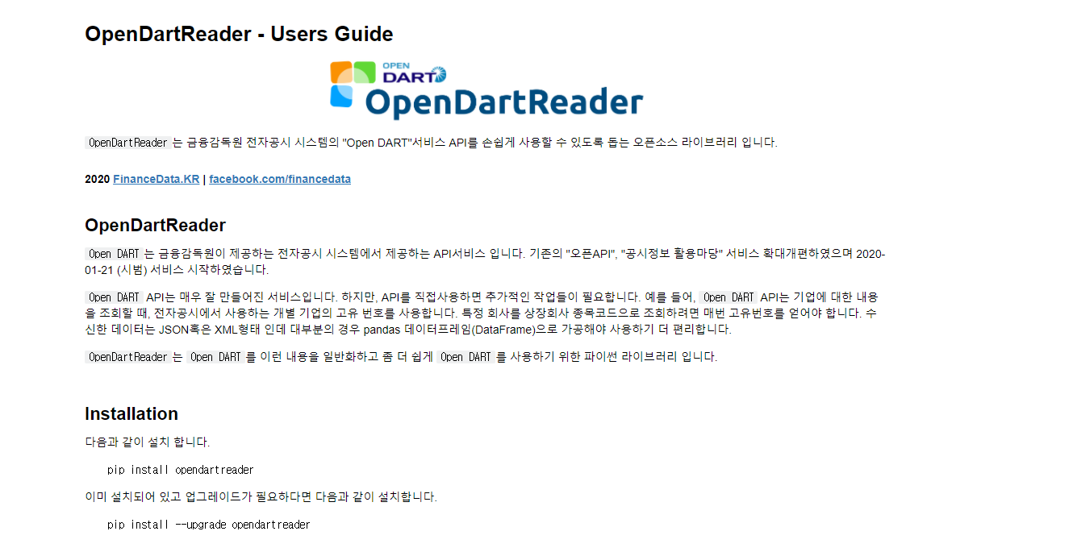
https://nbviewer.jupyter.org/github/FinanceData/OpenDartReader/blob/master/docs/OpenDartReader_users_guide.ipynb

